Slide 1
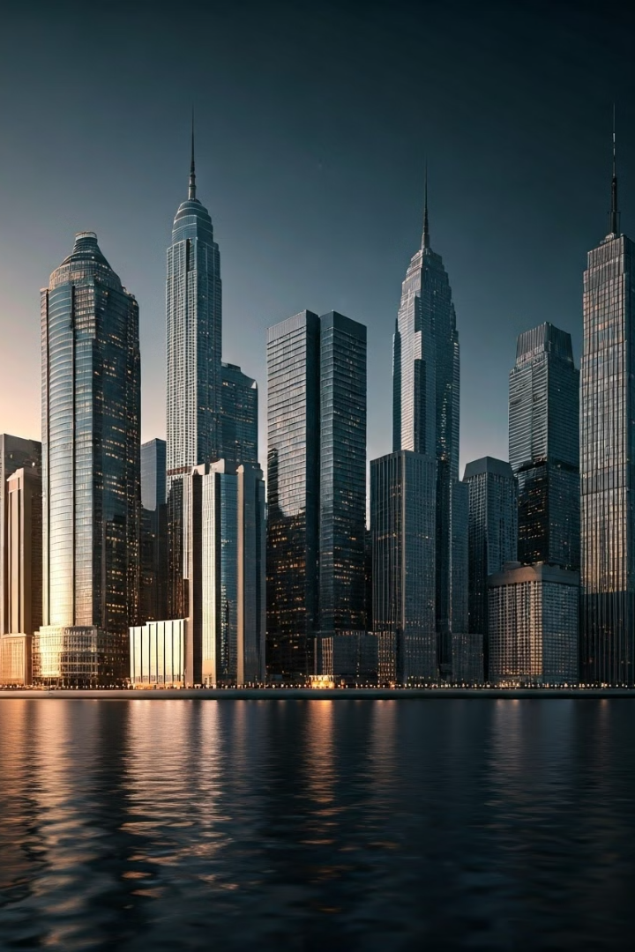
GVI MAPPER
By Abdus Sami Ch, Maria Altaf & M.Umar Riaz
The GVi Mapper offers a cutting-edge solution for real-time 3D mapping across various sectors. It empowers industries by integrating continuous visual data streams into accurate, dynamic models.

Slide 2
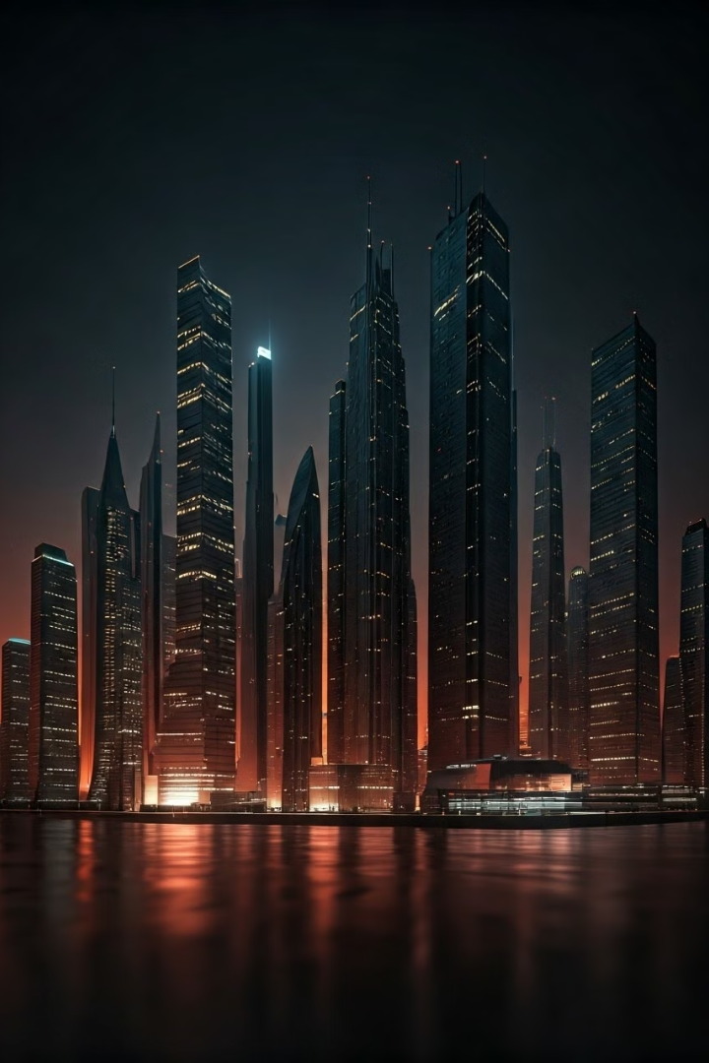
Introduction to GVi Mapper
Real-time 3D Models
Versatile Applications
GVi Mapper turns real-world visuals into 3D models instantly, enhancing analysis.
It serves sectors like security, construction, and architecture, tailoring solutions efficiently.
Efficient Decision-Making
The system provides clear data for informed decisions, optimizing field-specific operations.

Slide 3
Relevant Works
3D Architecture Design
3D Home Design
Security Enhancements
Drones capture detailed architectural environments, supporting precise 3D modeling.
Advanced tools visualize and adjust home structures, facilitating renovation processes.
Swarm drones generate real-time maps to improve situational security awareness.

Slide 4
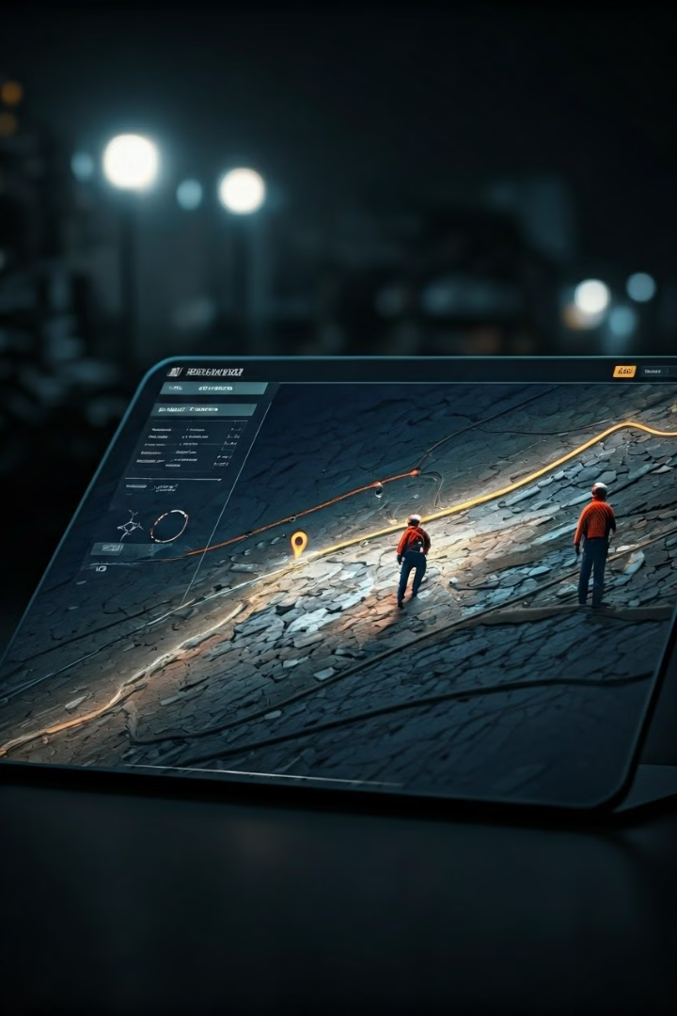
Additional Applications
1
Investigation Aid
2
Precision in 3D Printing
3D mapping reveals vital data for exploring unknown regions during investigations.
Highly accurate models guide the creation of physical objects, replicating complex designs.

Slide 5
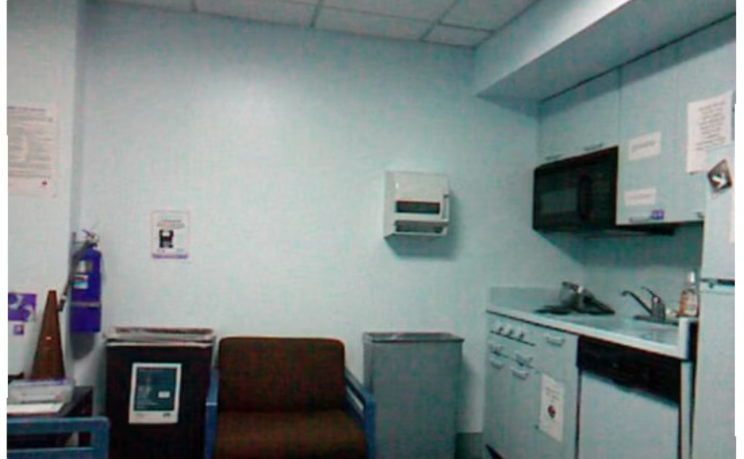
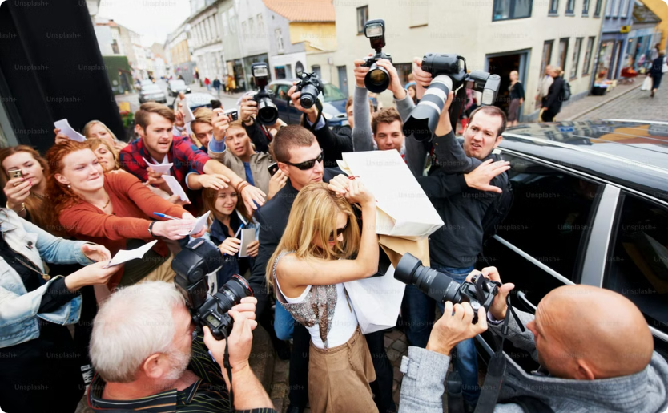
Understanding Depth Images
Spatial Data Capture
Depth Reconstruction
Each pixel’s intensity measures object distance, aiding 3D model construction.
Crucial spatial information is utilized to rebuild the depth of environments.

Slide 6
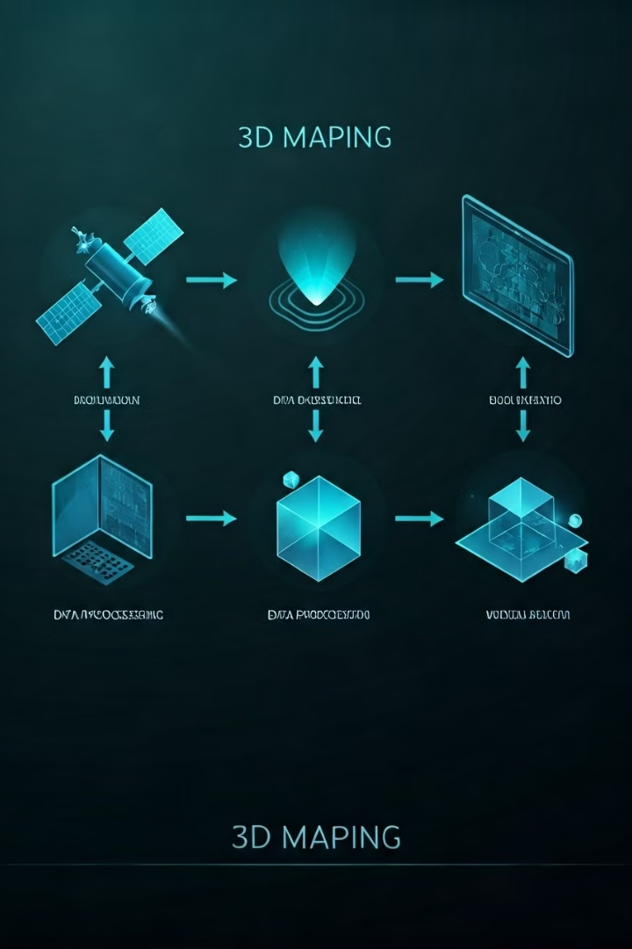




Workflow of GVi Mapper
Image Capture
Collection of initial data through varied imaging techniques.
Depth Map Creation
Generated maps with detailed spatial information of surfaces.
3D Point Cloud Formation
Translating depth maps into a point representation of structures.
3D Model Construction
Final model building, providing a comprehensive 3D visualization.

Slide 7

Conclusion
GVi Mapper revolutionizes 3D mapping, offering real-time, actionable insights for multiple industries. Reach out with any queries to explore its potential in your field.

